Slide 1

Presentation
Group 02
Software Engineering (A)
SP25 – BSE – 003
SP25 – BSE – 010
SP25 – BSE – 070
SP25 – BSE – 082
SP25 – BSE – 091
SP25 – BSE – 106
--------------------------
A group presentation on how Information and Communication Technology (ICT) is applied in the following sectors:
1 . Expert Systems
2 . Digital Currencies
07 – 06 -2025

Slide 2
ICT IN EXPERT SYSTEM

Slide 3
Introduction to Expert Systems
Expert systems are AI-powered computer programs designed to simulate human expert reasoning. They operate using a structured knowledge base and a set of logical rules to offer solutions or recommendations.
Example:
A medical expert system that recommends diagnoses based on patient symptoms.

Slide 4
Expert Systems - Application 1 Medical Diagnosis
Medical expert systems like MYCIN and IBM Watson help doctors analyze patient data to suggest treatments.
These tools reduce human error and improve the accuracy of diagnoses, especially in under-resourced areas.

Slide 5
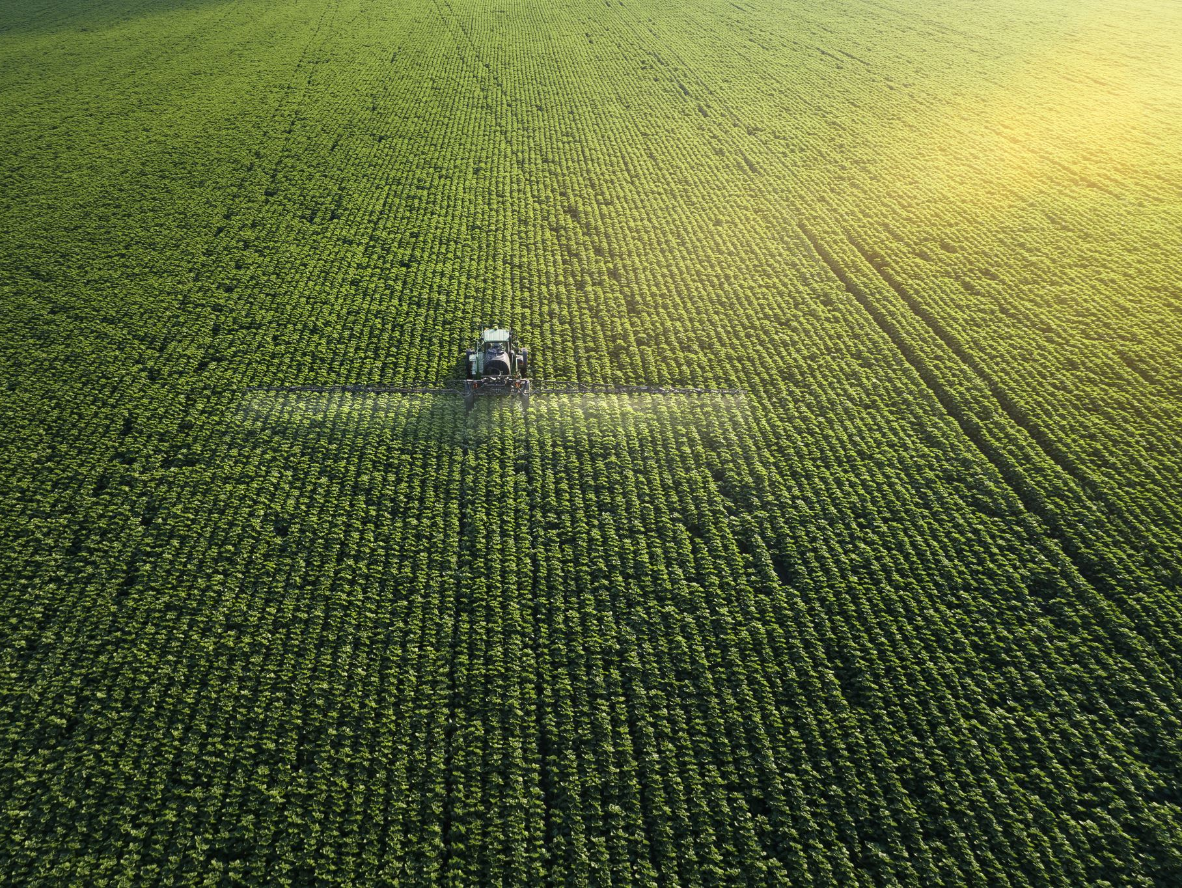
Application 2 Agriculture
Systems like DSSAT assist farmers in planning irrigation, choosing fertilizers, and predicting crop outcomes.
They enhance productivity by using local soil, weather, and crop data to generate tailored advice.

Slide 6
Expert systems in technical support automate responses to frequent user issues through chatbots.
This saves time, lowers cost, and allows 24/7 service for customers
Technical Support

Slide 7
Limitation of expert system
Expert systems are often confined to a narrow knowledge area and cannot operate outside it.
They require significant resources to build, and keeping their knowledge base updated is challenging.

Slide 8

Expert Systems Limitations
They lack human intuition and may perform poorly with ambiguous or incomplete information.
Incorrect data can lead to inaccurate recommendations, impacting decision quality.

Slide 9

Expert Systems - Challenges
Knowledge acquisition from domain experts is complex and time-consuming.
Deployment in real-world settings involves compatibility, integration, and training challenges.

Slide 10
Expert Systems - Challenges
User resistance to technology can limit adoption of expert systems.
Maintaining expert-level reliability requires constant monitoring and refinement.

Slide 11

Expert Systems - Future Trends
Integration with AI and machine learning will allow systems to self-improve over time.
Cloud-based expert systems will increase accessibility and reduce costs.

Slide 12
Expert Systems - Future Trends
Voice-enabled expert systems will improve accessibility.
Adaptive learning mechanisms will allow systems to evolve with real-time data.

Slide 13
ICT IN DIGITAL CURRENCY

Slide 14

ICT in Digital Currencies
Digital currencies are purely electronic forms of money that are managed, exchanged, and stored using digital systems. They leverage cryptographic techniques and online networks for secure, fast, and transparent transactions.
Example: Using Bitcoin to make online purchases across international borders.

Slide 15

Digital Currencies - Application 1 Online Transactions
Platforms like PayPal and Google Pay allow secure and convenient digital payments online.
These systems support contactless transactions and reduce the need for physical cash.

Slide 16
Digital Currencies - Application 2 Crypto Investment
Exchanges like Binance and Coinbase provide trading and investing in cryptocurrencies.
Investors are attracted to digital currencies due to their high return potential despite market risks.

Slide 17

Digital Currencies - Application 3 International Transfers
Services like Ripple enable fast and low-cost cross-border payments.
These platforms are especially useful in regions with limited traditional banking infrastructure.

Slide 18
Digital Currencies - Limitations
High energy usage by blockchain-based systems like Bitcoin raises environmental concerns.
Limited acceptance and infrastructure reduce their utility in daily transactions.

Slide 19

Digital Currencies - Limitations
Cryptocurrencies are volatile, leading to uncertainty in value.
There is an increased risk of cybercrime, including scams and digital wallet hacks.

Slide 20

Digital Currencies - Challenges
Regulatory uncertainty creates hesitation for businesses and investors.
Public understanding of how digital currencies work remains low in many areas.

Slide 21

Digital Currencies - Challenges
Cybersecurity is a major concern due to the threat of hacking and theft.
Infrastructure for digital transactions is lacking in rural and underdeveloped areas.

Slide 22
Digital Currencies – Future Trends
Central Bank Digital Currencies (CBDCs) are being developed for secure, government-backed digital money.
Sustainable blockchain technologies are emerging to reduce energy consumption.

Slide 23
Digital Currencies - Future Trends
Global acceptance of digital currencies is increasing with better regulations.
Integration with mobile apps and e-wallets will improve accessibility and usage.
Interoperability between multiple digital currencies will support seamless transactions across platforms.

Slide 24

